Slide 1
WGST 100-991: Introduction to Women’s and Gender Studies
Week 11: Wednesday, Nov. 14/18
Gendered Identities: Culture of Femininity
Cultural Representations and Body Politics: The Feminine and Sexuality

Slide 2
Recap-Femininity: Qualities
Femininity: Term used to describe the qualities of women.
The common acceptance of the notion of femininity has been challenged by women’s movements for several decades.
However, typically there are two prominent sets of expectations:
Nurturance, Empathy, and Interdependence: women are expected to express care and concern for others, often putting the needs of others ahead of their own, and are expected to be relationship orientated
Appearance: women are expected to be concerned about their appearance, especially beauty and slenderness

Slide 3
Recap-Femininity-Negative Outcomes
Ceding Power: By focusing primarily on the needs of others women cede power, decision-making, and the majority of control over their lives to men who, in turn, may not be looking out explicitly for their best interests.
Distorted Image: Image becomes not just an ideal but an obsession.
Women can suffer from internalized oppression where they discipline their bodies to achieve the emphasized ideal, regardless of the costs.

Slide 4
Recap-Femininity-Catastrophic Outcomes
The result can contribute to several harmful trends:
Social inequality at work, in the family, and even in all relationships which leads to an underclass of over half the population
Increased health problems as women try to attain the perfect appearance that does not really exist (beauty myth)
Increased isolation, depression, and even psychosis that can lead to self inflicted wounds or even suicide

Slide 5
Sexuality-What do we think of?
When we think of sexuality what comes to mind?

Slide 6
Sexuality: The History-Middle Ages (1000-1400)
The romanticized notion:
In poetry, literature, and epics
Women were idealized as the living embodiment of sexuality
Men were to become almost fanatically devoted to one
Expected to woo his lady love
To be the subject of all attention and serenading
Marriage and paramours

Slide 7
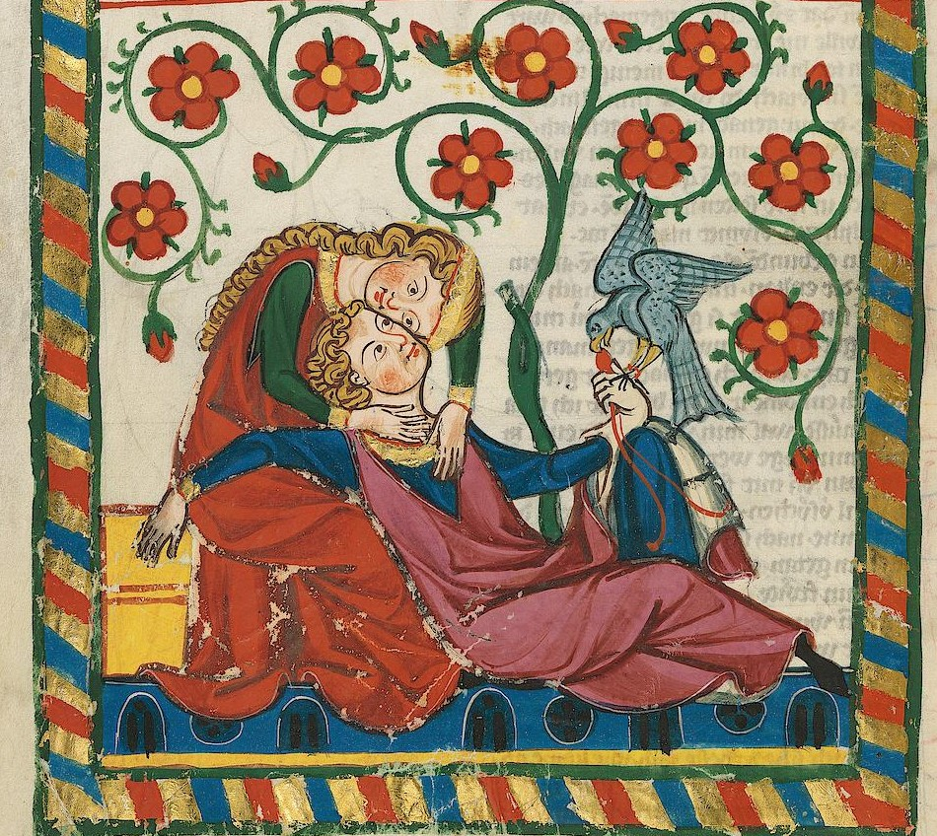
Sexuality: The History-Middle Ages (1000-1400)

Slide 8
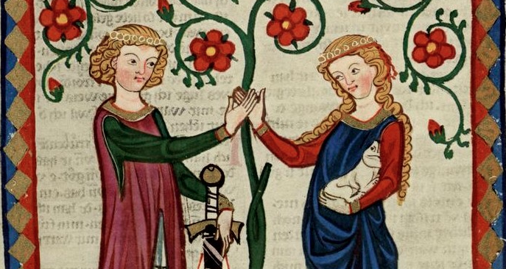
Sexuality: The History-Middle Ages (1000-1400)

Slide 9
Sexuality: The History-Middle Ages (1000-1400)
The Reality:
Property and babymakers
Marriage an exchange of chattel and property rights
Entire point to make babies to either carry out family name and legacy (the rich) or to supply future generations of laborers
Laws of women as nothing more as property extreme and based on class
Church dominance of society views sexuality as wicked

Slide 10
Sexuality: The History-European Renaissance (1440-1680)
Women understood to be intellectually inferior to men
Driven solely by insatiable sexual appetites
Only men were mentally equipped for connections such as friendship and valued relations
Marriage seen as a way to curb the biological insatiable sexual urges of women and to protect men female seductions

Slide 11
Sexuality: The History-European Renaissance (1440-1680)
The contradiction:
Women seen as weak minded and inferior
Yet men need to be protected from the power of women?

Slide 12
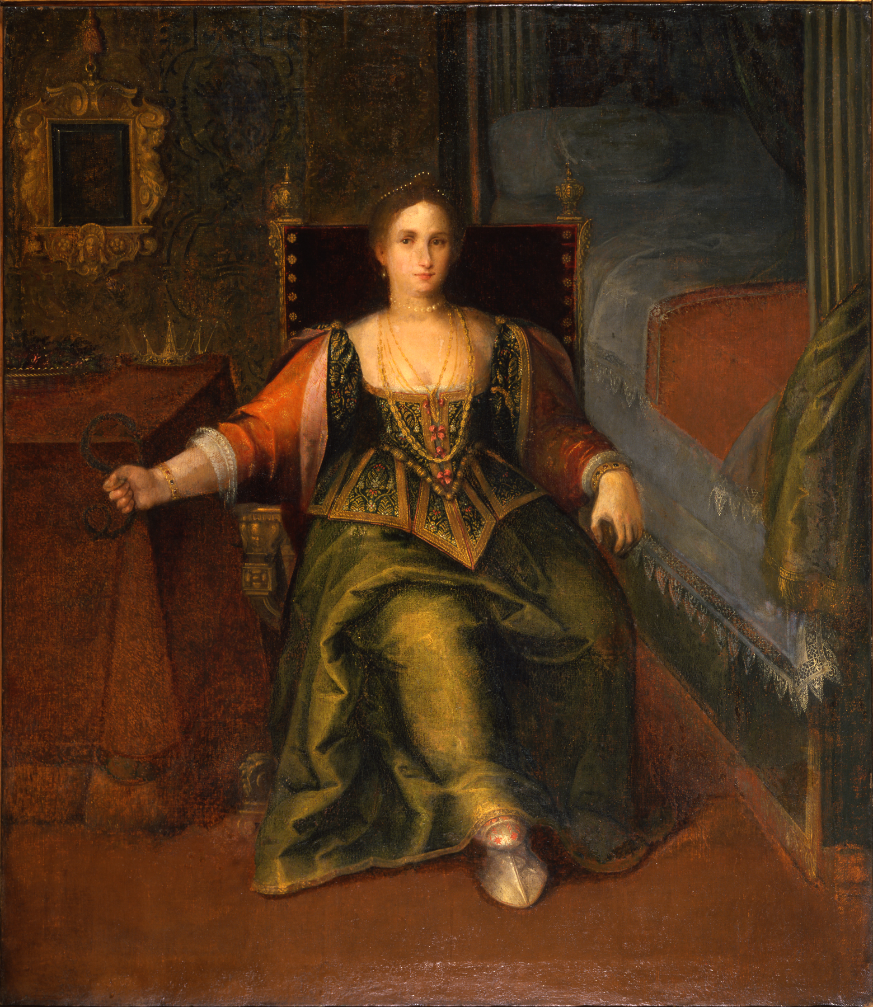
Sexuality: The History-European Renaissance (1440-1680)

Slide 13
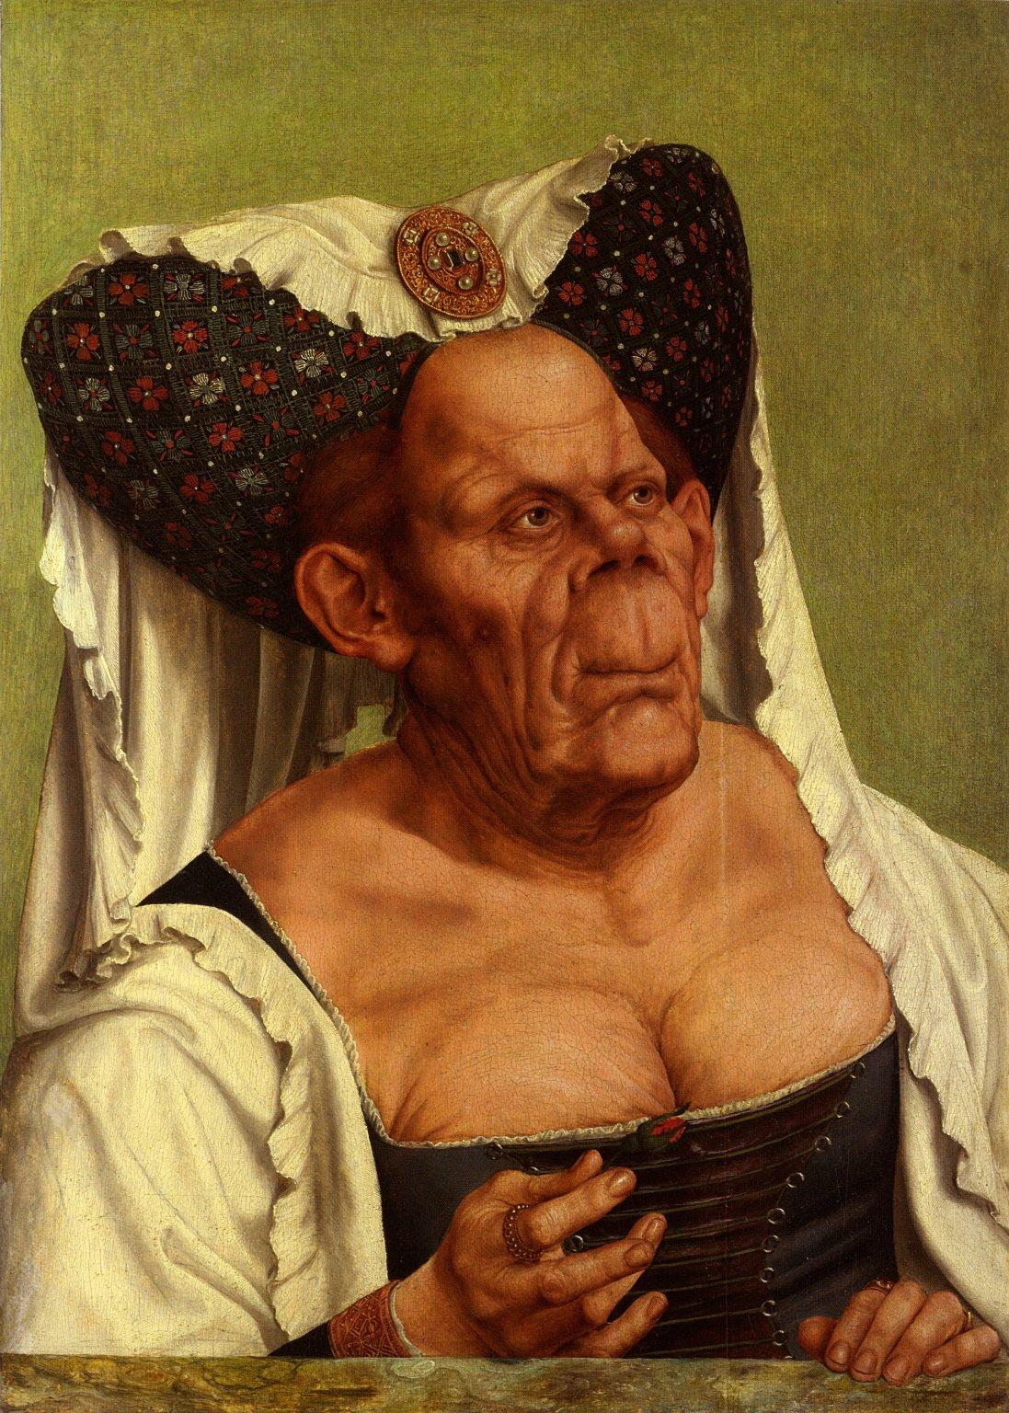
Sexuality: The History-European Renaissance (1440-1680)

Slide 14
Sexuality: The History-Pre Industrial England (1680-1800)
Women still property and babymakers
Essential that women be virgins upon marriage to ensure inheritance of the child
Lack of proof of this makes the child ineligible
To prove purity, bridal sheet put on public display
In cases of royalty, consummation was observed as an event in and of itself

Slide 15
Sexuality: The History-Pre Industrial England (1680-1800)
Men had no restrictions
In fact, it was expected they be sexually active….just not with unmarried aristocratic women
Only servants and serfs who had no legal say in the matter
Illegitimate children had no rights or legal protections
Creates an underclass of impoverished

Slide 16
Sexuality: The History-Victorian England (1800-1900)
Sex and class based sexual double standard taken to extremes
Aristocratic women were constantly monitored until they “came out”
They were then introduced to society and expected to find a husband
Chastity still a requirement
Men, as in the previous age, had complete sexual freedoms
Sex trade was very active during this time
At least 50,000 sex worker sin London alone
Male and female prostitutes
STD’s rampant and, inevitably, passed on from aristocratic men to their chaste brides who were blamed for impropriety

Slide 17
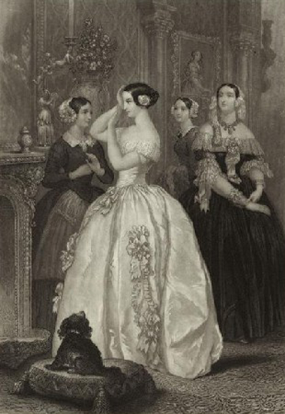
Sexuality: The History-Victorian England (1800-1900)

Slide 18
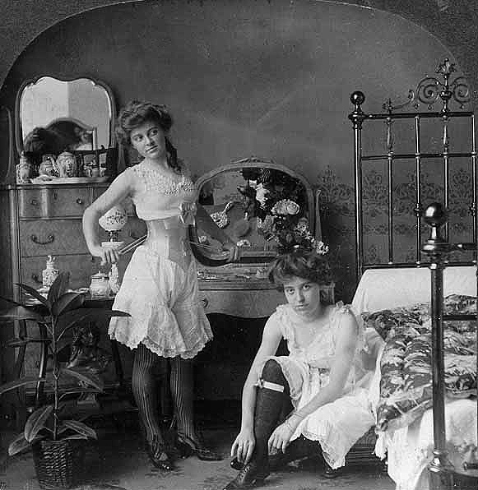
Sexuality: The History-Victorian England (1800-1900)

Slide 19
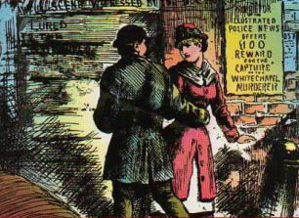
Sexuality: The History-Victorian England (1800-1900)

Slide 20
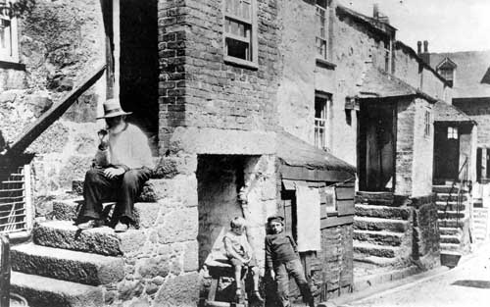
Sexuality: The History-Victorian England (1800-1900)

Slide 21
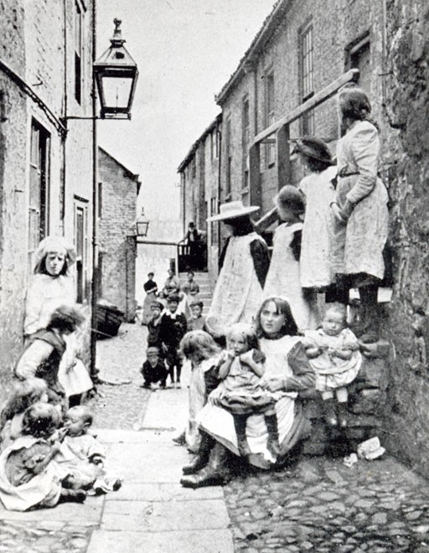
Sexuality: The History-Victorian England (1800-1900)

Slide 22
Sexuality: Sex Scripts
What the historical context suggests is that we follow sex scripts.
These scripts follow patterns of sexual expression, norms, identity and performance.

Slide 23
Sexuality: Sex Scripts
Subjects of Scripts include:
Sex of partner
Premarital sex
Sexual positions
Sexual stamina
Sex during menstruation
place

Slide 24
Sexuality: Sex Scripts
Purpose of Sex:
Procreation
Recreation
Relationship
Casual
Type of partner

Slide 25
Sexuality: Sex Scripts
Sex scripts also include definitions of appropriate sexuality as well as roles within sexual encounters or sexual interaction.
While desires can be attributes to biology there is a good deal of social construction as well.
For example: the sexual nature of certain body parts are very much socially constructed. In some cultures the sight of a woman’s ankles is considered erotically stimulating. In North America breasts are a source of fixation for heterosexual men. This suggests that there is nothing particularly inherently sexual or erotic about body parts but really just a socially constructed trigger of desire.

Slide 26
Sexuality: The Boundaries of Sexuality
These social constructions tend to fall along socially normative patterns about what is “proper” sexual expression.
For example, Heternormativity or the assumption and requirement that one engage in sexual relations only with opposite sex partners.
Sexuality is practice: an individual may think of ones self as gay, straight, or bisexual but engage in sexual activities that might be outside those categories.
For example: a man can say he is “not gay” yet still fantasize about same sex or even engage in sex with men.
Sexuality is identity: gay, lesbian, bisexual, heterosexual, transexual.
In short, it can mean many things over time, place, and circumstance.

Slide 27
Sexuality: Modern Views
Michel Foucault
Suggests that never before has society been so obsessed with describing, analyzing, and reacting to its own sexual activity.
According to Foucault, western society has problematized sex and sexuality to such a degree that we are constantly monitoring, adjusting, and controlling the sexuality of ourselves and others.
We have gotten to the point of complete irrationality…..too much or too little sex means medical help is available.
Example: “sex addiction”
We call those engaging in “abnormal” sexual activities and practices deviants, medicalize it, and demand they seek help. This has simply resulted in the proliferation of “cures” to help the sexually dysfunctional person.

Slide 28
Sexuality: Modern Views
This medicalization has of sexuality has continued and proliferated.
Example: The Diagnostic and Statistical Manual of Mental Illnesses (DSM)
Sexual dysfunction of both sexes can be treatable
Homosexuality once thought to be a severe mental illness
Hysteria considered to be a result of too much sexual stimulation for a woman
Masturbation a sign of mental illness that can be treated

Slide 29
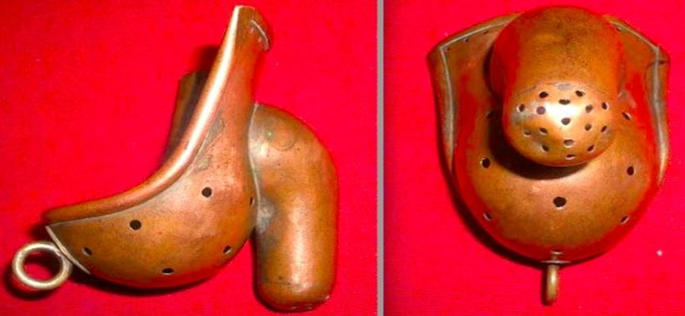
Sexuality: Modern Views, Anti-Masturbation Armour

Slide 30
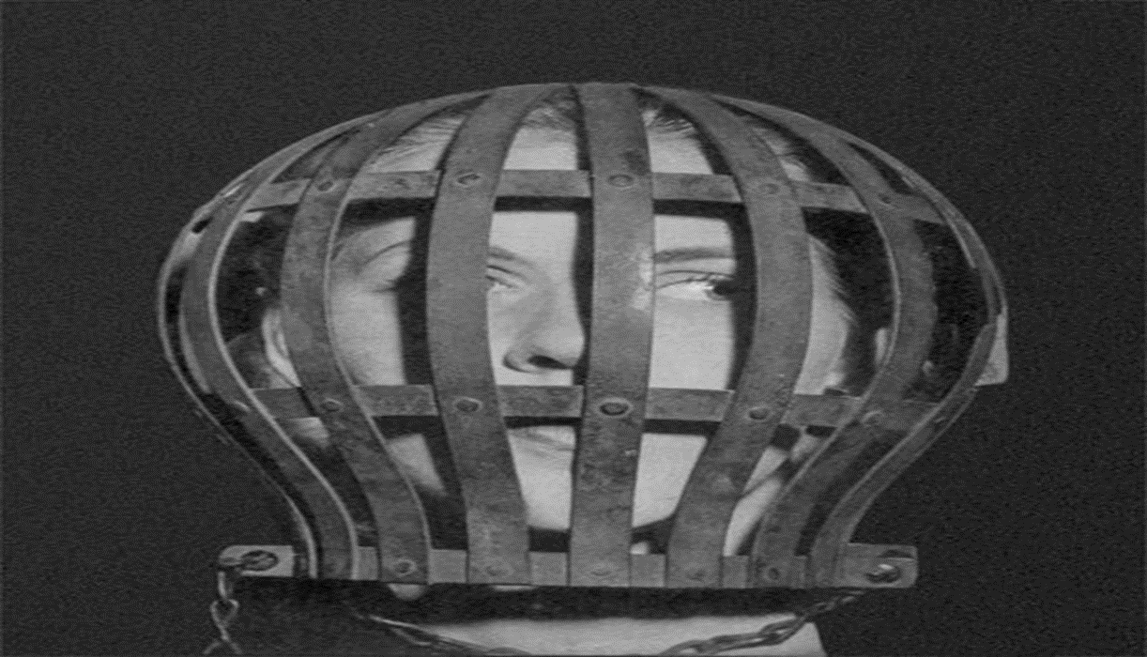
Sexuality: Modern Views, Anti-Masturbation Armour

Slide 31
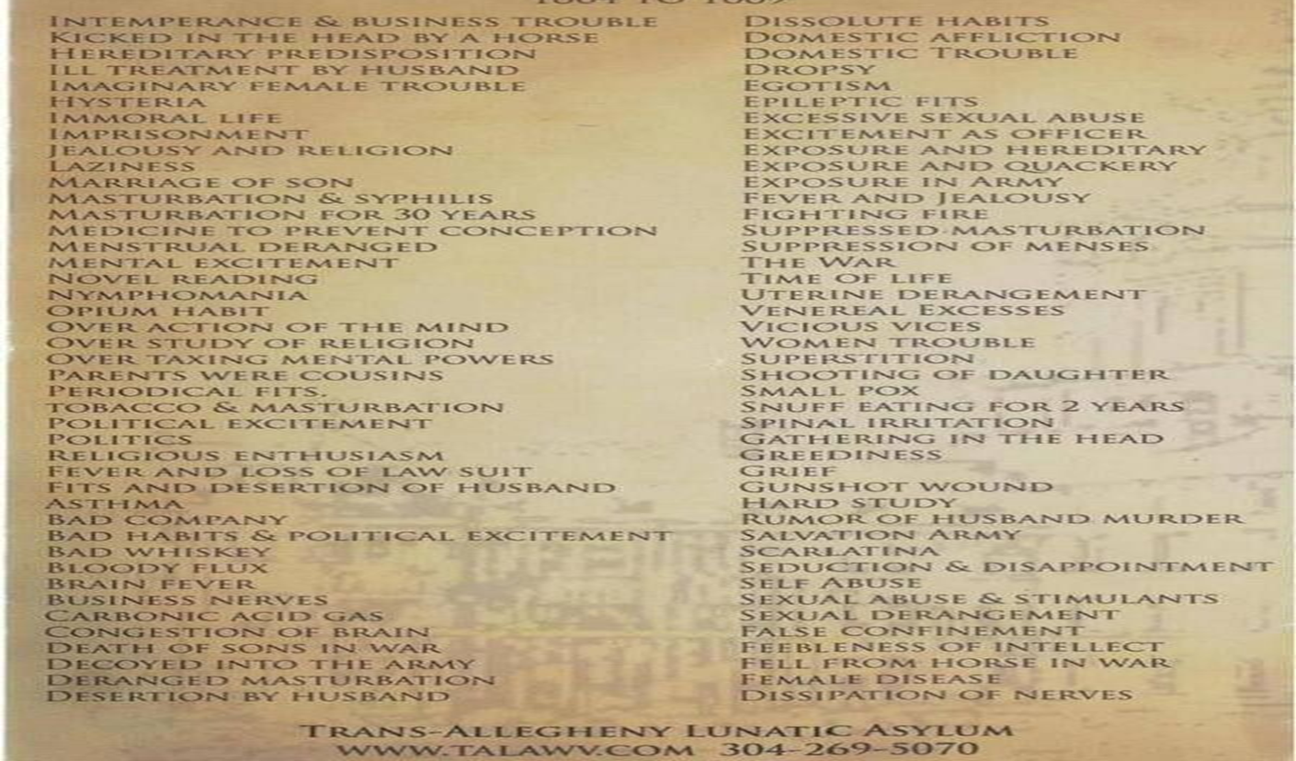
Sexuality: Modern Views

Slide 32
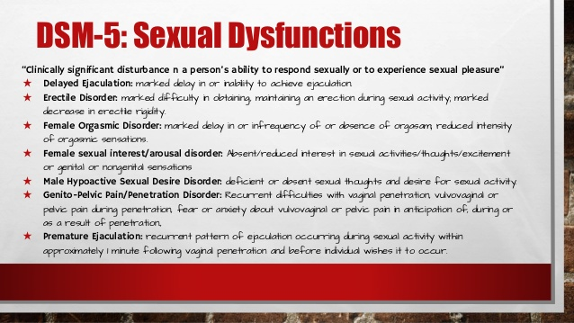
Sexuality: Modern Views

Slide 33
Sexuality: Modern Views
Another modern twist on sexuality is its commodification.
Commodification: the transformation of goods, services, ideas and not least people into commodities or objects of trade. A commodity at its most basic, is "any thing intended for exchange," or any object of economic value.
The classic example is modelling and fashion.

Slide 34
Sexuality: Modern Views-the Fashion Example
Throughout the 20th century:
https://www.youtube.com/watch?v=bjEQLpyULP8
Today:
https://www.youtube.com/watch?v=jaWvdJBVBSc

Slide 35
Sexuality: Outside the Scripts
Sex scripts change over time as societies and the culture within it evolves.
Until they do scripts have the unfortunate ramification of determining what is normal and abnormal.
Those acting outside the scripts are often treated as deviants and marginalized.
The more extreme the worse the social punishment.
Ex. Diagnosing sexuality outside the script as a mental illness.

Slide 36
Sexuality: Outside the Scripts
Until recently LGBTQ communities were outside the mainstream sex scripts.
While the disadvantages are obvious there are some advantages as well.
It can be advantageous because it frees people form larger cultural expectations .
According to research done by Blumstein and Schwartz what it is to be gay and lesbian are usually learned after contact within the LGBTQ communities.
This means individuals are not constricted to mainstream versions of what it is to be LGBTQ and can learn organically.
In short, identity is less stereotyped and more pure in form.

Slide 37
Sexuality: Outside the Scripts
Why did it take so long to finally be accepted?
CBC. 2015. How We Got Gay.
https://www.youtube.com/watch?v=foQrmKRUFgg
The backlash of “legalization”:
https://www.youtube.com/watch?v=GP4B5d8zDVo

